Slide 1

Sleep Information Session
Barwic Parade Primary School
02.09.19
An introduction to the science of sleep
This Photo by Unknown Author is licensed under CC BY

Slide 2
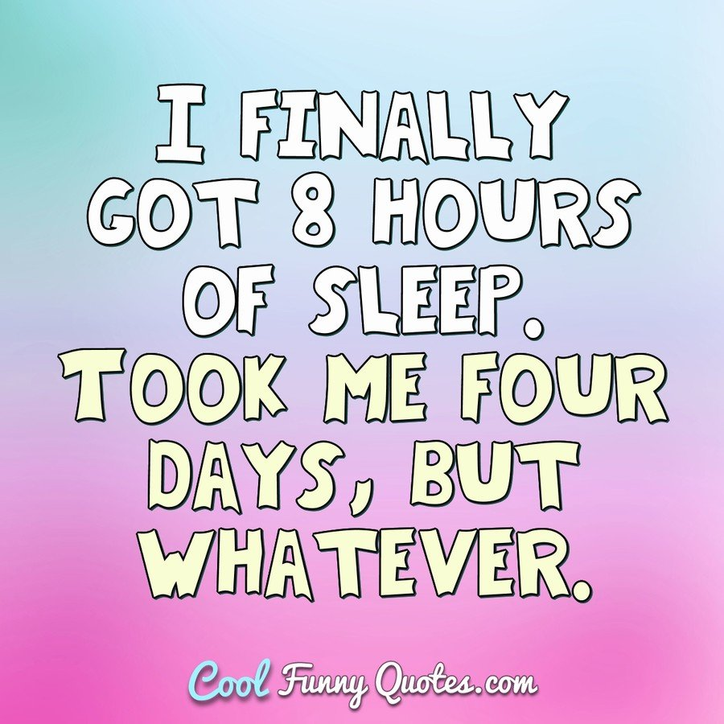
Aims of the session
To raise awareness of
Why we need sleep
The sleep process
What happens to the body and brain when we sleep
To introduce the Sleep Scotland Sound Sleep Primary Resource Pack
To identify a personal sleep target (if you want to)
Complete sleep quiz

Slide 3
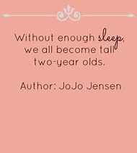
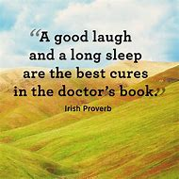
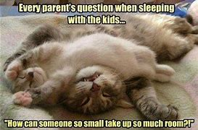
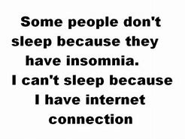
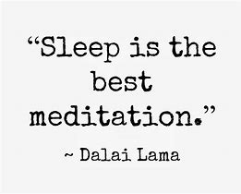

Slide 4

What is sleep?
Sleep is-
A natural behaviour. Without exception, every animal species studied to date sleeps or engages in something remarkably like it. No matter how hard we fight it we will want to sleep for at least part of every 24 hours
A reversible state of reduced awareness to our environment and surroundings
Dynamic – we do not turn off completely during sleep. There are lots of important processes occurring during sleep that are vital to our existence.
Who sleeps for how long?

Slide 5
The stages of sleep
There are two kinds of sleep that we all experience at some point during the night. The two types are:
• Rapid eye movement (REM) sleep.
• Non-rapid eye movement (NREM) sleep.
NREM sleep is divided into three stages:
Stages N1 and N2: these are known as light sleep. Stage N1 is brief a transitional stage from wake to sleep.
Stage N2 is the stage of sleep in which we spend most of the time (around 40– 50% of the total sleep time)
Stage N3: this is known as deep sleep or slow-wave sleep (20–25% of the total sleep time).
We go through each type of sleep several times during the night in cycles which comprise of the different stages of sleep. Each cycle lasts approximately 1½-2 hours and we will go through 4-6 cycles each night. We get most of our deep sleep in the first third of the night. The amount of REM sleep we have increases throughout the night. Children and adults spend around 20% of total sleep time in REM sleep.

Slide 6
What does sleep look like? What happens when you sleep?
Hypnograms (page 3)
Sleep patterns are shown as hypnograms. A hypnogram is created by gathering lots of physiological information, essentially it shows the different types of sleep being experienced over the course of a night. The hypnogram in fig.1 is of a child sleeping through a full 11 hours.
The hypnogram shows the child awake at the start of the night, then going into the lighter (N1 & N2) and deeper (N3) stages of NREM sleep. They then move back into lighter sleep (N1 & N2) before going into their first period of REM sleep (shown in red). This
The pattern continues through the night, in cycles of REM and NREM sleep lasting approximately 90 - 120 minutes. Notice that there is more deep (stage N3) sleep at the start of the night, and that the REM periods get longer as the night progresses.
At some points the child wakes up (for periods that can be as short as fractions of a second) and then goes back to sleep - this is perfectly normal. Eventually, they start to waken up naturally after around 10-11 hours. A typical child’s hypnogram will show that a child has more slow wave sleep than an adult. It is another indication that children do sleep differently to adults.
Chart page 5
What happens when you sleep? (youtube.com what happens when you sleep - matthew walker london real)

Slide 7
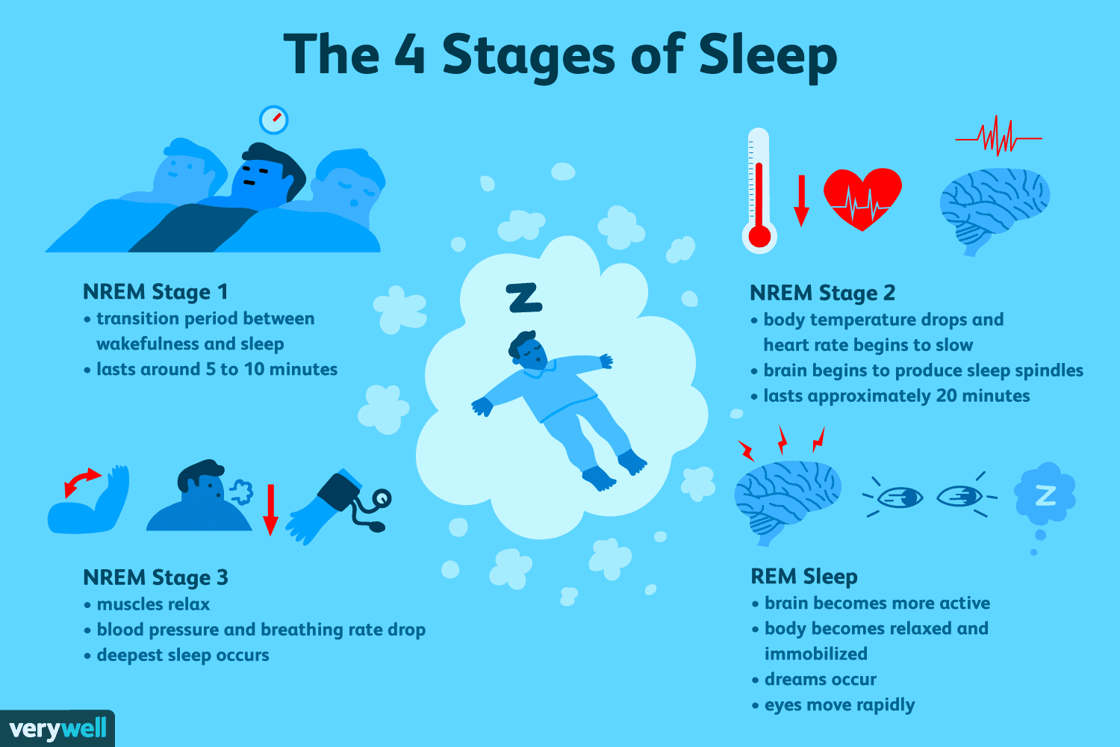
What our bodies are doing during sleep
See table 1 activity of the body during different stages of sleep (page 5)

Slide 8
How does your body know when it’s time to sleep? Circadian rhythm and sleep pressure
There are two main factors that determine when you want to sleep and when you want to be awake. The first is a signal beamed out from your internal 24 hour clock which is deep within your brain. Our circadian rhythm or body clock is controlled by the suprachiasmatic nucleus (SCN). The SCN is made up of a group of cells located in a part of the brain called the hypothalamus which is shown in fig 4 below. Everyone generates a circadian rhythm (circa meaning “around” and dian, derivative of diam, meaning “day”).
In order to keep our circadian rhythm regulated, our bodies react to external stimuli called zeitgebers (‘time-givers’). Light is one of the most important zeitgebers. Other zeitgebers include; meals, social interactions, exercise, external temperature and sound.
Zeitgebers reset our body clocks every day. We are designed to want to sleep through the darkest period of the 24 hours and be active and alerted during the day.
The second factor is a chemical substance called adenosine that builds up in your brain and creates “sleep pressure”, also known as homeostatic sleep drive. The longer you’ve been awake, the more the chemical sleep pressure accumulates, and consequently, the sleepier you feel.
It is the balance between these two factors which dictates how alert and attentive you are during the day, when you feel tired and ready for bed at night, and, in part, how well you sleep at night.

Slide 9
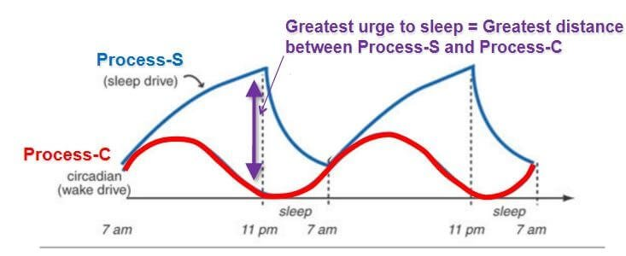
Circadian rhythm and homeostatic sleep drive

Slide 10
melatonin
Melatonin is a hormone that is produced by all mammals and is vital in the regulation of our circadian rhythm. It is released in response to darkness and is often called the ‘sleepy hormone’ because its release is one of the triggers that tells the body that it is time to prepare for sleep.
In the human eyes, there are light receptors that are not designed to help us see but are linked to our body clocks. Our body clocks detect a change from light to dark and send signals to the pineal gland, where melatonin is produced, to secrete the hormone.
Research has discovered that the SCN is most sensitive to short-wavelength light within the blue spectrum which is the part of the spectrum that blue LED light is found. As a consequence, evening blue LED light has twice the harmful impact on night time melatonin suppression than the warm light from the old incandescent bulbs. LED lights are found in most electronic gadgets. Using LED lights impacts our natural sleep rhythms, the quality of our sleep and how alert we feel during the day.
See graph

Slide 11
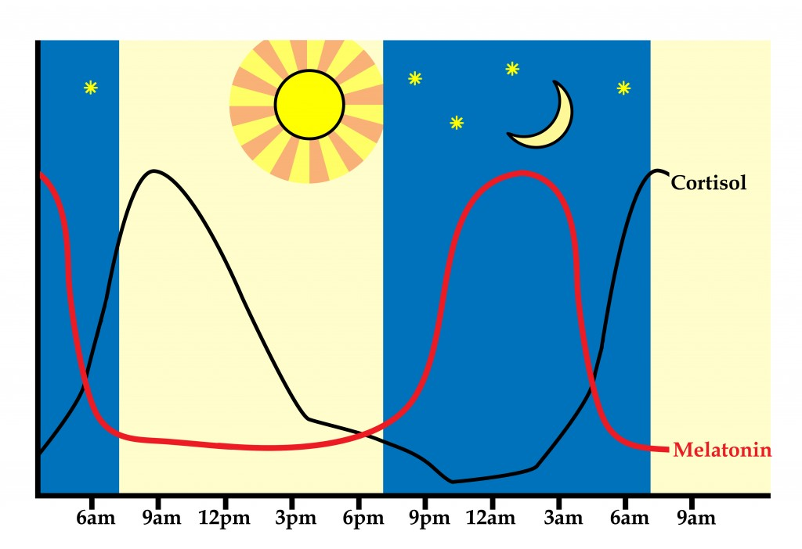
cortisol
Cortisol is released in the early morning to help wake us up and prepare for the day’s activities. Levels of cortisol can increase in the bloodstream by as much as 50-160% within 30 minutes of waking up.
Lack of sleep can cause the levels of cortisol to the body to
increase which in turn effects the ability to settle to sleep at night.
See circadian rhythm pattern over 24 hours

Slide 12
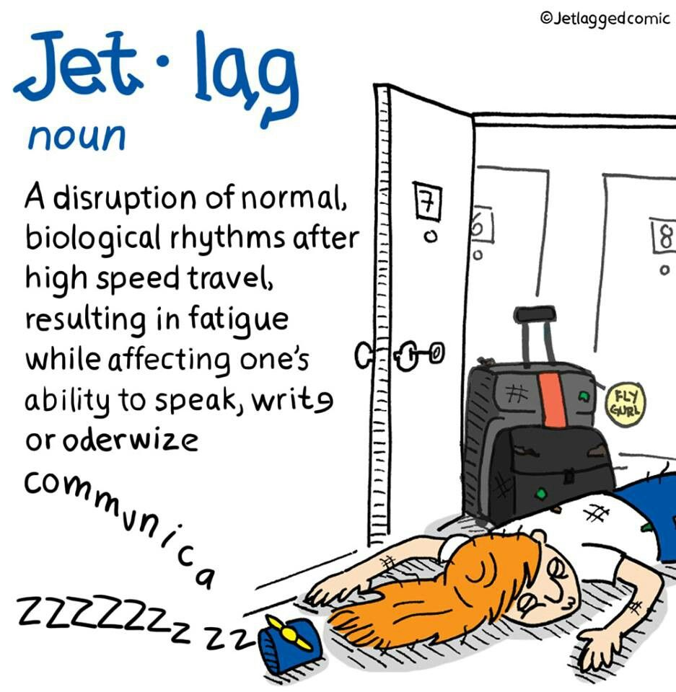
Working with our circadian rhythm and problems with our body clock
Our bodies can cope with those slight variations so long as we get the right amount of good quality sleep. Children are just the same. There will be some who are ‘night owls’ and some who are ‘morning larks’. The problem for the ‘night owls’ is that they still have to get up at 7.30am to get to school on time. They need to understand how to work with their circadian rhythm to get the best out of the day. Any clock can be adjusted and that includes our body clocks.
If you travel regularly and have had to deal with jet lag, you have experienced what happens when your body clock has to adjust to a change in time. Your circadian rhythm will also be affected by working night shifts or irregular sleep patterns.
Are you an Owl or Lark? Complete the questionnaire.
https://www.ted.com/talks/matt_walker_sleep_is_your_superpower#t-11644

Slide 13
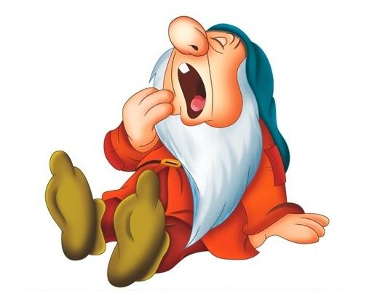
What happens when we do not sleep? How do we feel?
Discuss what happens physically, mentally and emotionally when we don’t get enough sleep? What might your children say if asked this question.
What happens to your body and brain if you don’t get enough sleep. Matthew walker – The Tech Insider (4:50)
Sleep behaviours questionnaire
Sleep Scotland Resources and sleep work with parents

Slide 14
Stimulants, sedatives and sleep
Caffeine is a stimulant found in tea, coffee and a variety of soft drinks. Caffeine can mute the sleep signal of adenosine (the chemical related to sleep pressure) for several hours. Caffeine tricks you into feeling alert and awake, despite the high levels of adenosine that would otherwise seduce you into sleep. High doses of caffeine make it hard to fall asleep and stay asleep. Caffeine may stay in your system for up to 24 hoursIn the 1990s NASA scientists exposed spiders to different stimulants and then observed the webs they constructed. The drugs included LSD, speed (amphetamine), marijuana and caffeine. Can you match the spider web to the stimulant? . (You tube.com How does caffeine effect sleep – Matthew Walker)
Alcohol is one of the most powerful suppressors of REM that we know of.. When the body metabolises alcohol it produces by-product chemicals called aldehydes and keytones. The aldehydes in particular will block the brains ability to generate REM (dream) sleep. Research on the impact of alcohol on learning over a period of several days, concluded that the overnight work of REM sleep which normally assimilates complex memory knowledge had been interfered with by the alcohol.
What might effect children’s sleep?

Slide 15
The Great British Bedtime report (2017) The Sleep council
We’re getting less sleep than in 2013. Almost three-quarters (74%) of Bits sleep less than seven hours per night while the number of people who said they get less than five hours of sleep has grown from 7% to 12%. For many people (61% of those questioned in 2017), between five to seven hours a night is the norm.
It’s led to a third of us (30% getting a poor night sleep most nights. The top 3 reasons remain the same as 2013: stress and worry (455 v 53%), partner disturbance (25%) and noise (20% v 18%).
Brits are increasingly turning to the bottle at bedtime. The number has spiked 9% in just four years. Now one in five people admit to drinking alcohol to help them nod of- with men (30%) more likely than women (20%) to do so.

Slide 16
The final slide
Check your sleep quiz answers
What can you do to improve you sleep?
Amazing Breakthrough
Scientists have discovered a revolutionary new treatment that makes you live longer. It enhances your memory and makes you more creative. It makes you look more attractive. It keeps you slim and lowers food cravings. It protect you from cancer and dementia. It wards off colds and flu. It lowers the risk of heart attacks and stroke, not to mention diabetes. You’ll even feel happier, less depressed, and less anxious. Are you interested? (From “Why We Sleep” – Matthew Walker)

