Slide 1
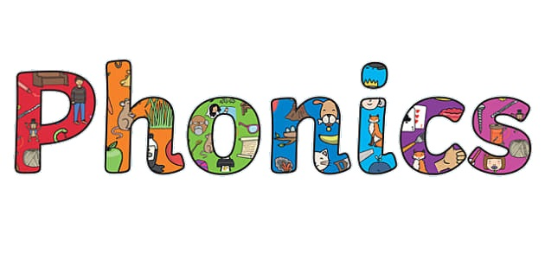

Welcome to Reception Phonics and Reading Workshop

Slide 2
Can you read this?
Buongiorno e benvenuto nel nostro seminario sulla lettura. Ti parlerò di come puoi aiutare a sostenere tuo figlio con la fonetica.

Slide 3
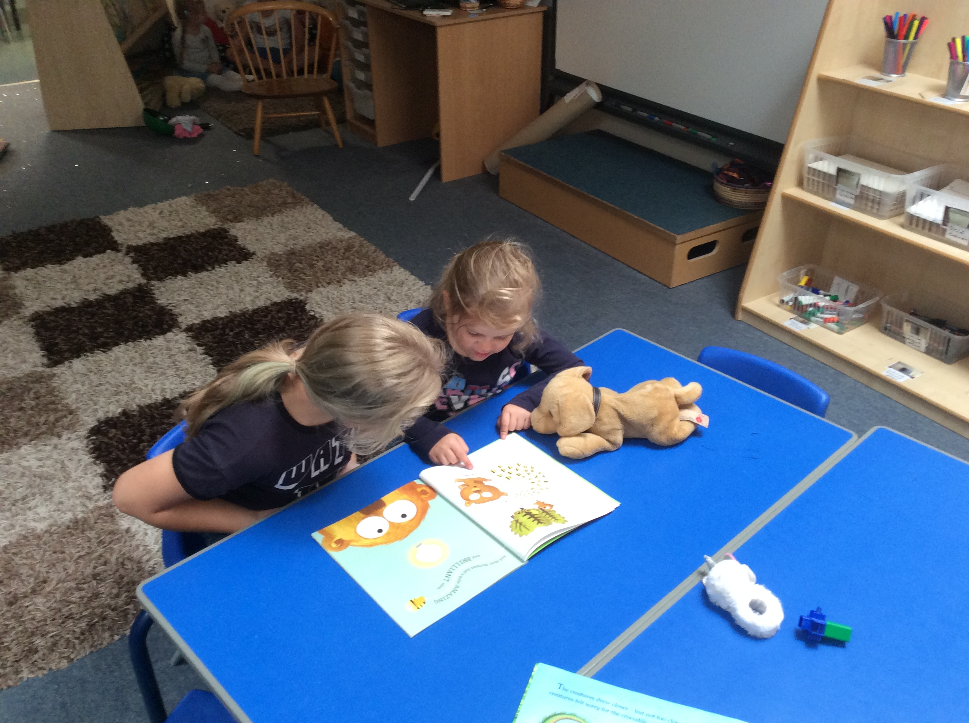
The Importance of Reading
Until your child can read, imagine how many things will not make sense around them.
Reading is not just sitting with a school book. It is a life skill. It allows us to delve into magical adventures.
The earlier the better, the sooner your child is able to read, the more successful and independent they will be.
Team work! We all need to work together.
The more you read the more you learn!

Slide 4
What is Phonics?
Words are broken down into individual sounds. We sound out each letter first, then blend them together.
We use Letters and Sounds.
6 phases
Our reading scheme matches each set of sounds. This allows the children to use and apply the same set of letters until they are secure in these.

Slide 5
The sound is … and the name is …
Digraph – two letters making one sound e.g ai in rain
Trigraph – three letters making one sound e.g ear in hear
Blending – pushing sounds together to create a word.
Tricky words- cannot be decoded.

Slide 6
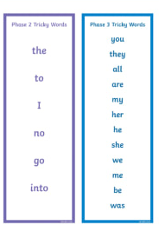
Sight words

Slide 7
We teach the pure sound as it is all about breaking down a word and being able to blend this together
Each letter taught has the letter name, the capital letter (upper case), a printed symbol and a handwritten symbol
A a
We do not write in capitals apart from the beginning of a sentence or the beginning of a name

Slide 8
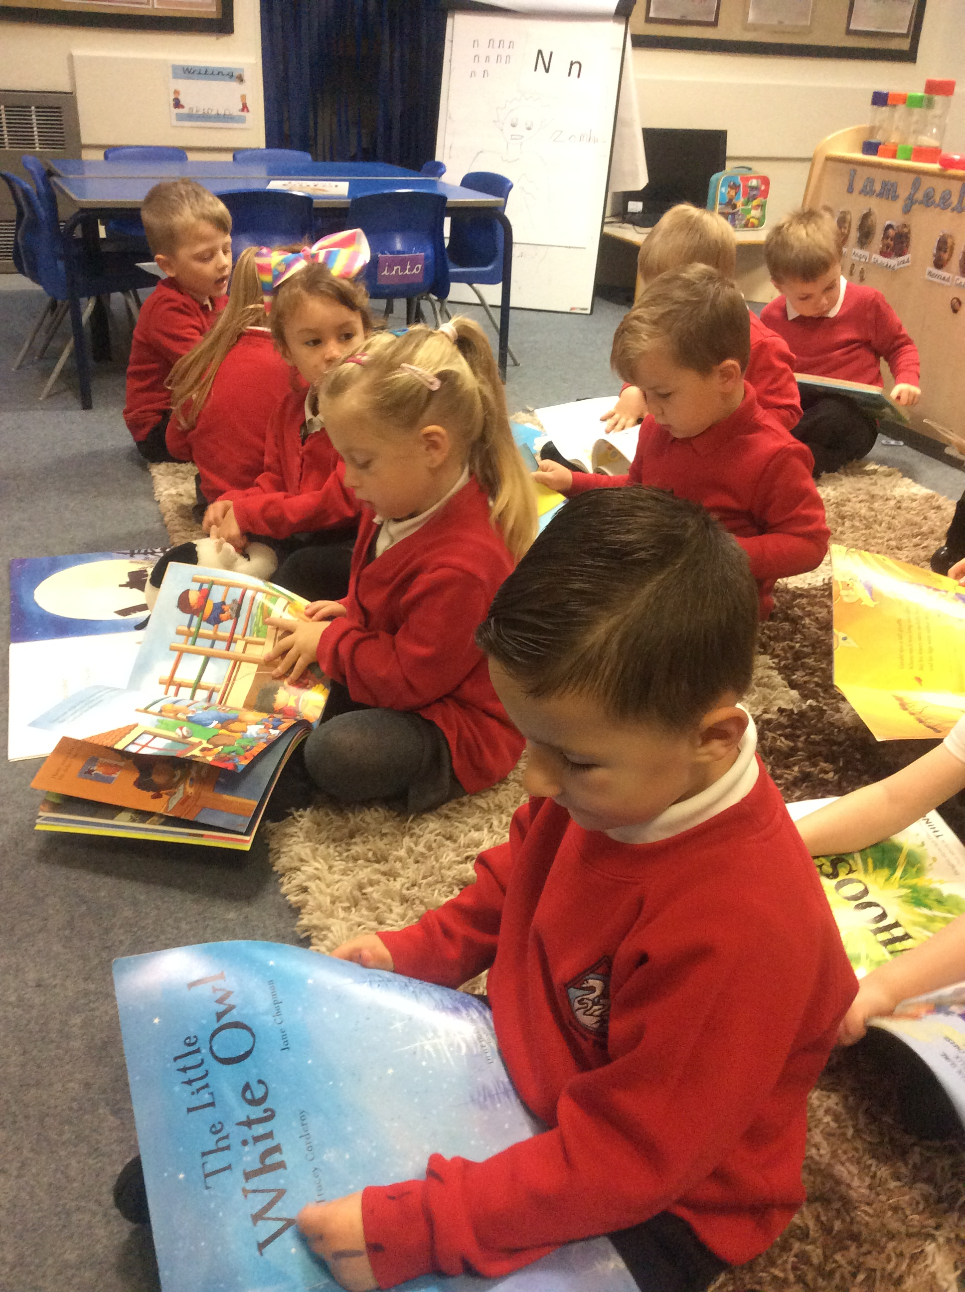
There are 44 sounds are there in the English Language!
Phonics first!
Phonics/reading and writing are all interlinked but also very very separate.
Phonics is always first – this gives children the ability to tune into individual sounds in words.

Slide 9
Phase 2
Set 1: s, a, t, p
Set 2: i, n, m, d
Set 3: g, o, c, k
Set 4: ck, e, u, r
Set 5: h, b, f, ff, l, ll, ss

Slide 10
Phase 3
When reading, support your children to recognise a digraph/trigraph in a word by circling it with a pen/ your finger.
Set 6: j, v, w, x
Set 7: y, z, zz, qu
Consonant digraphs: ch, sh, th, ng
Vowel digraphs: ai, ee, igh, oa, oo, ar, or, ur, ow, oi, ear, air, ure, er

Slide 11
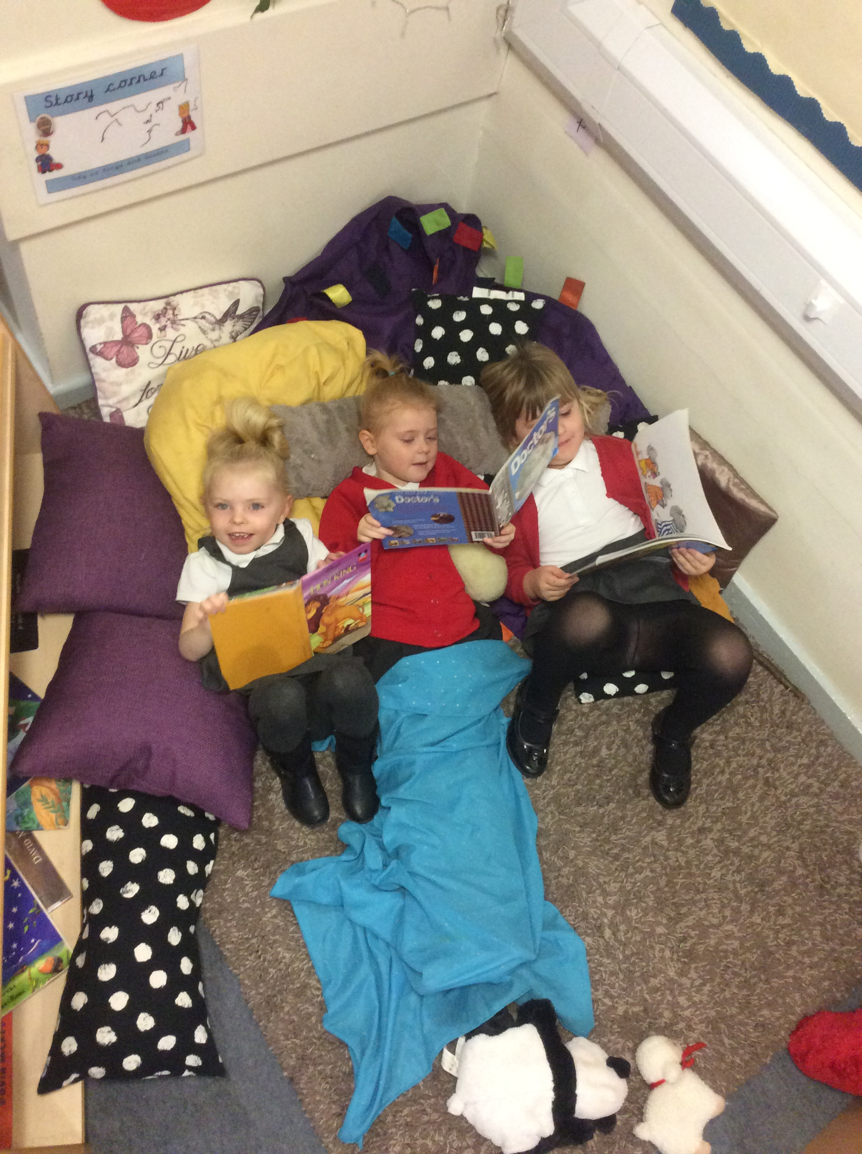
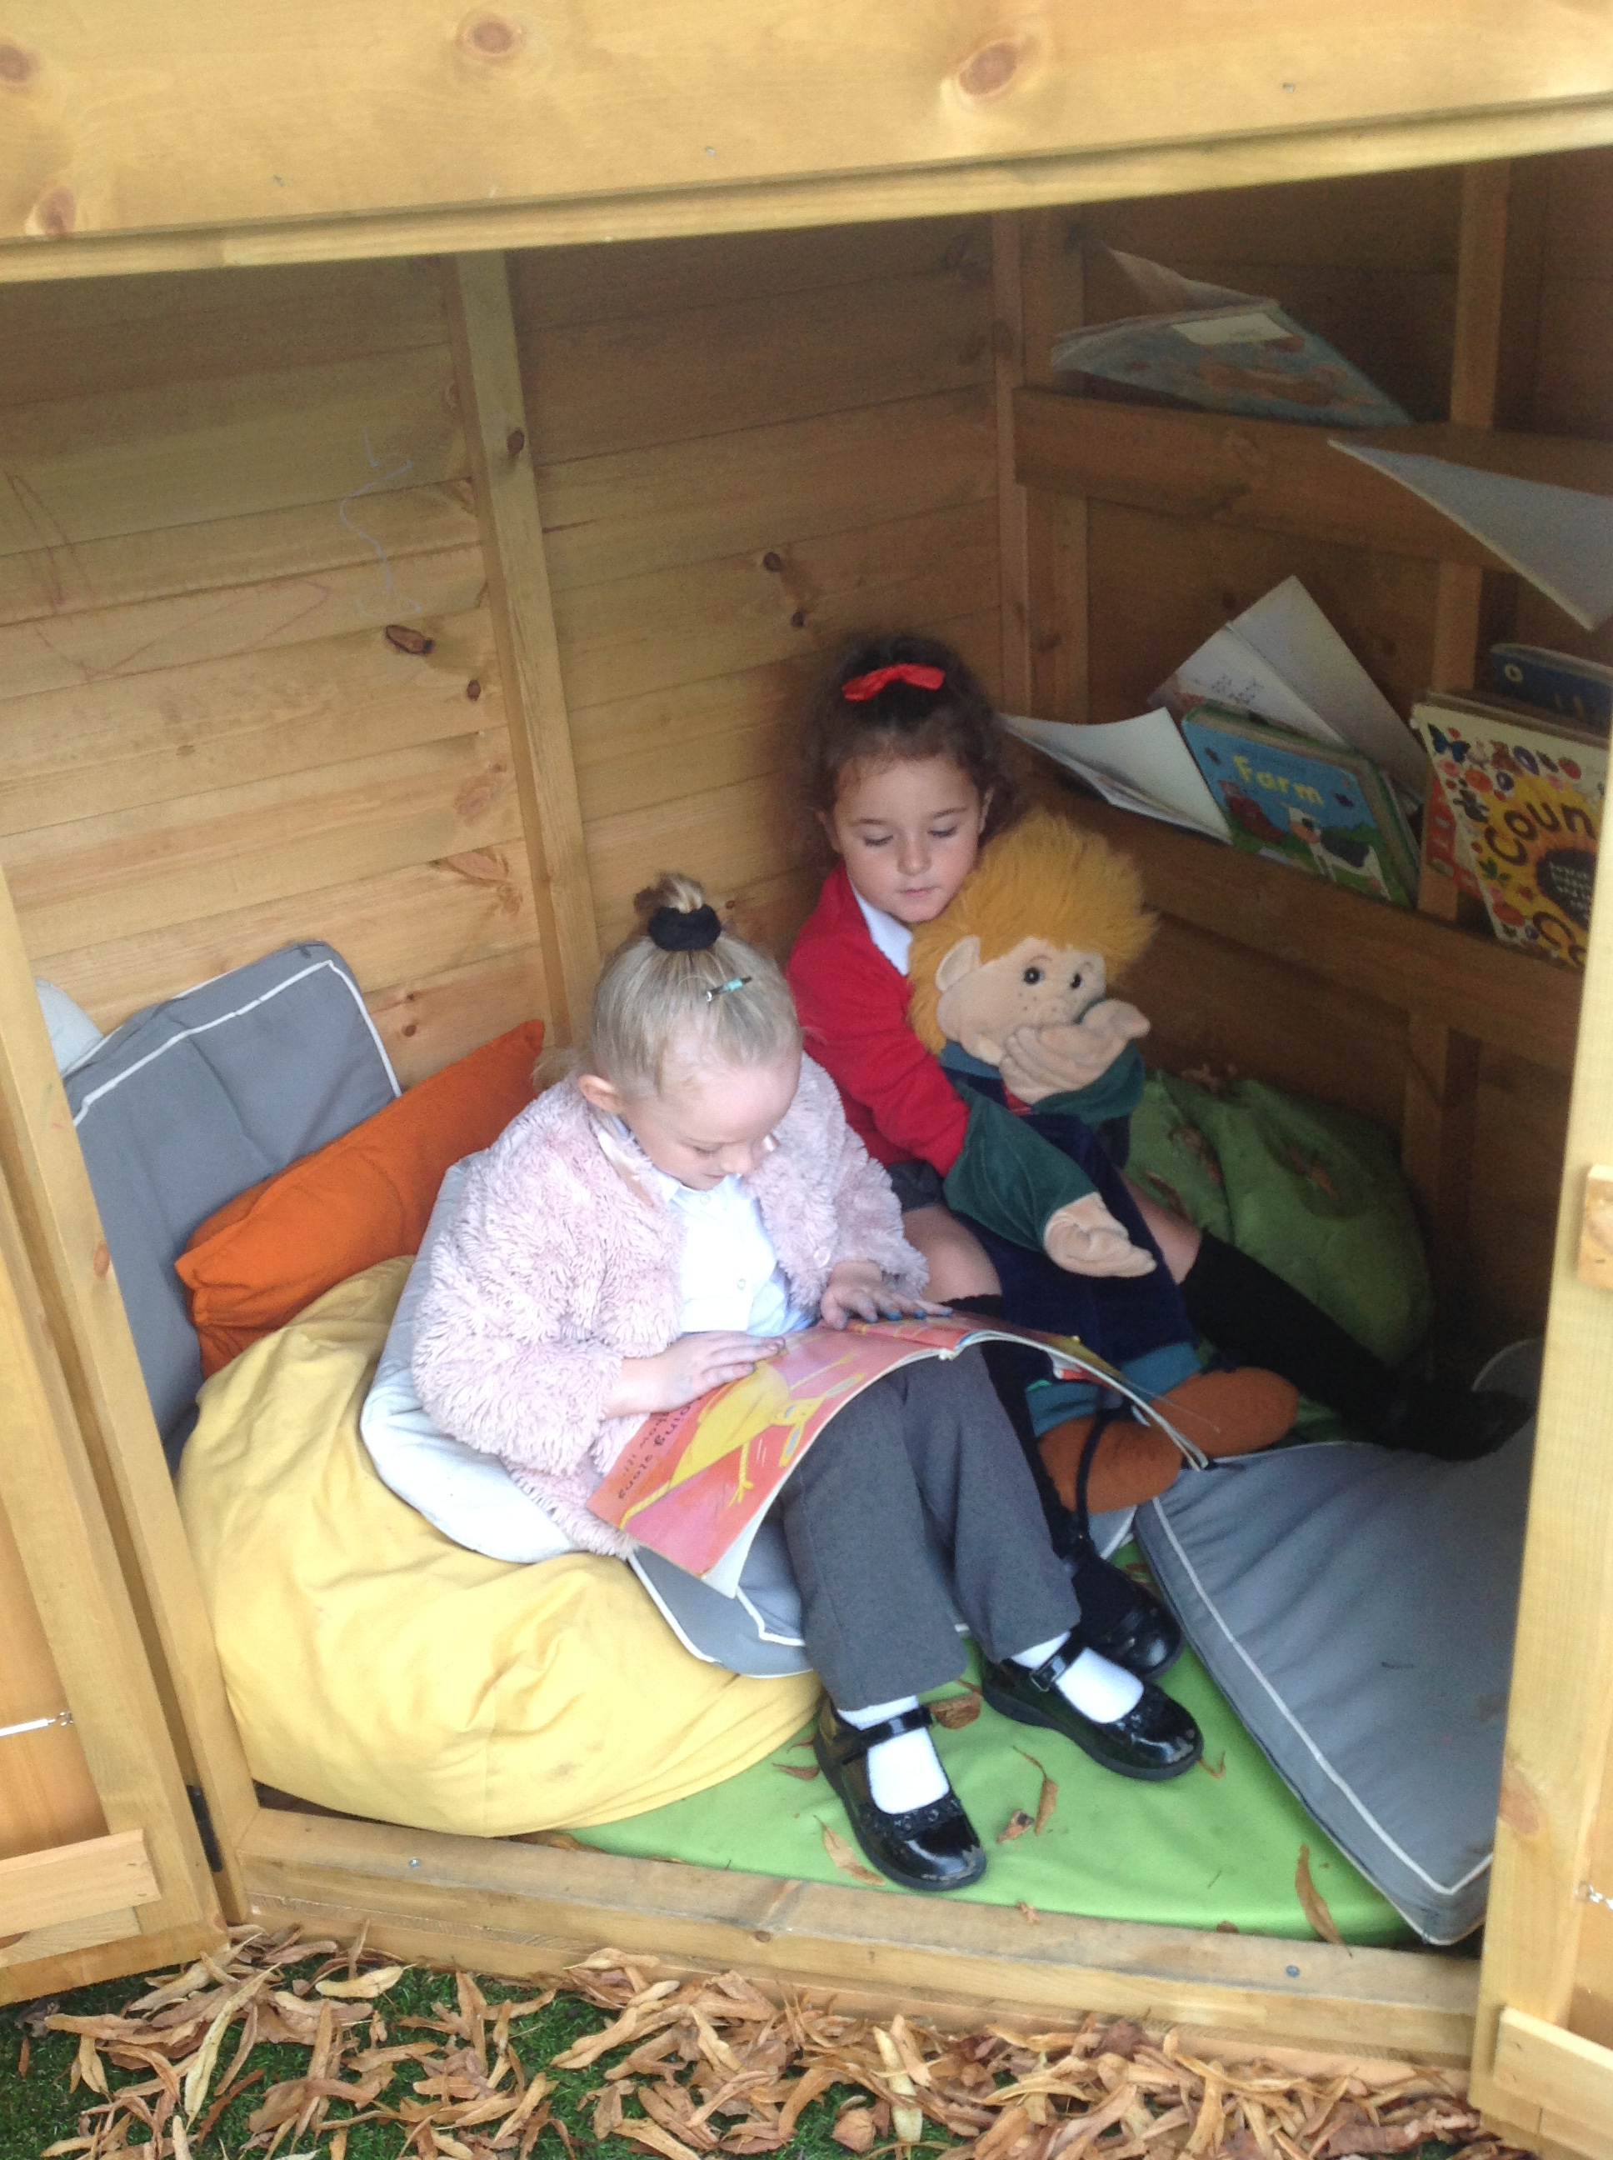
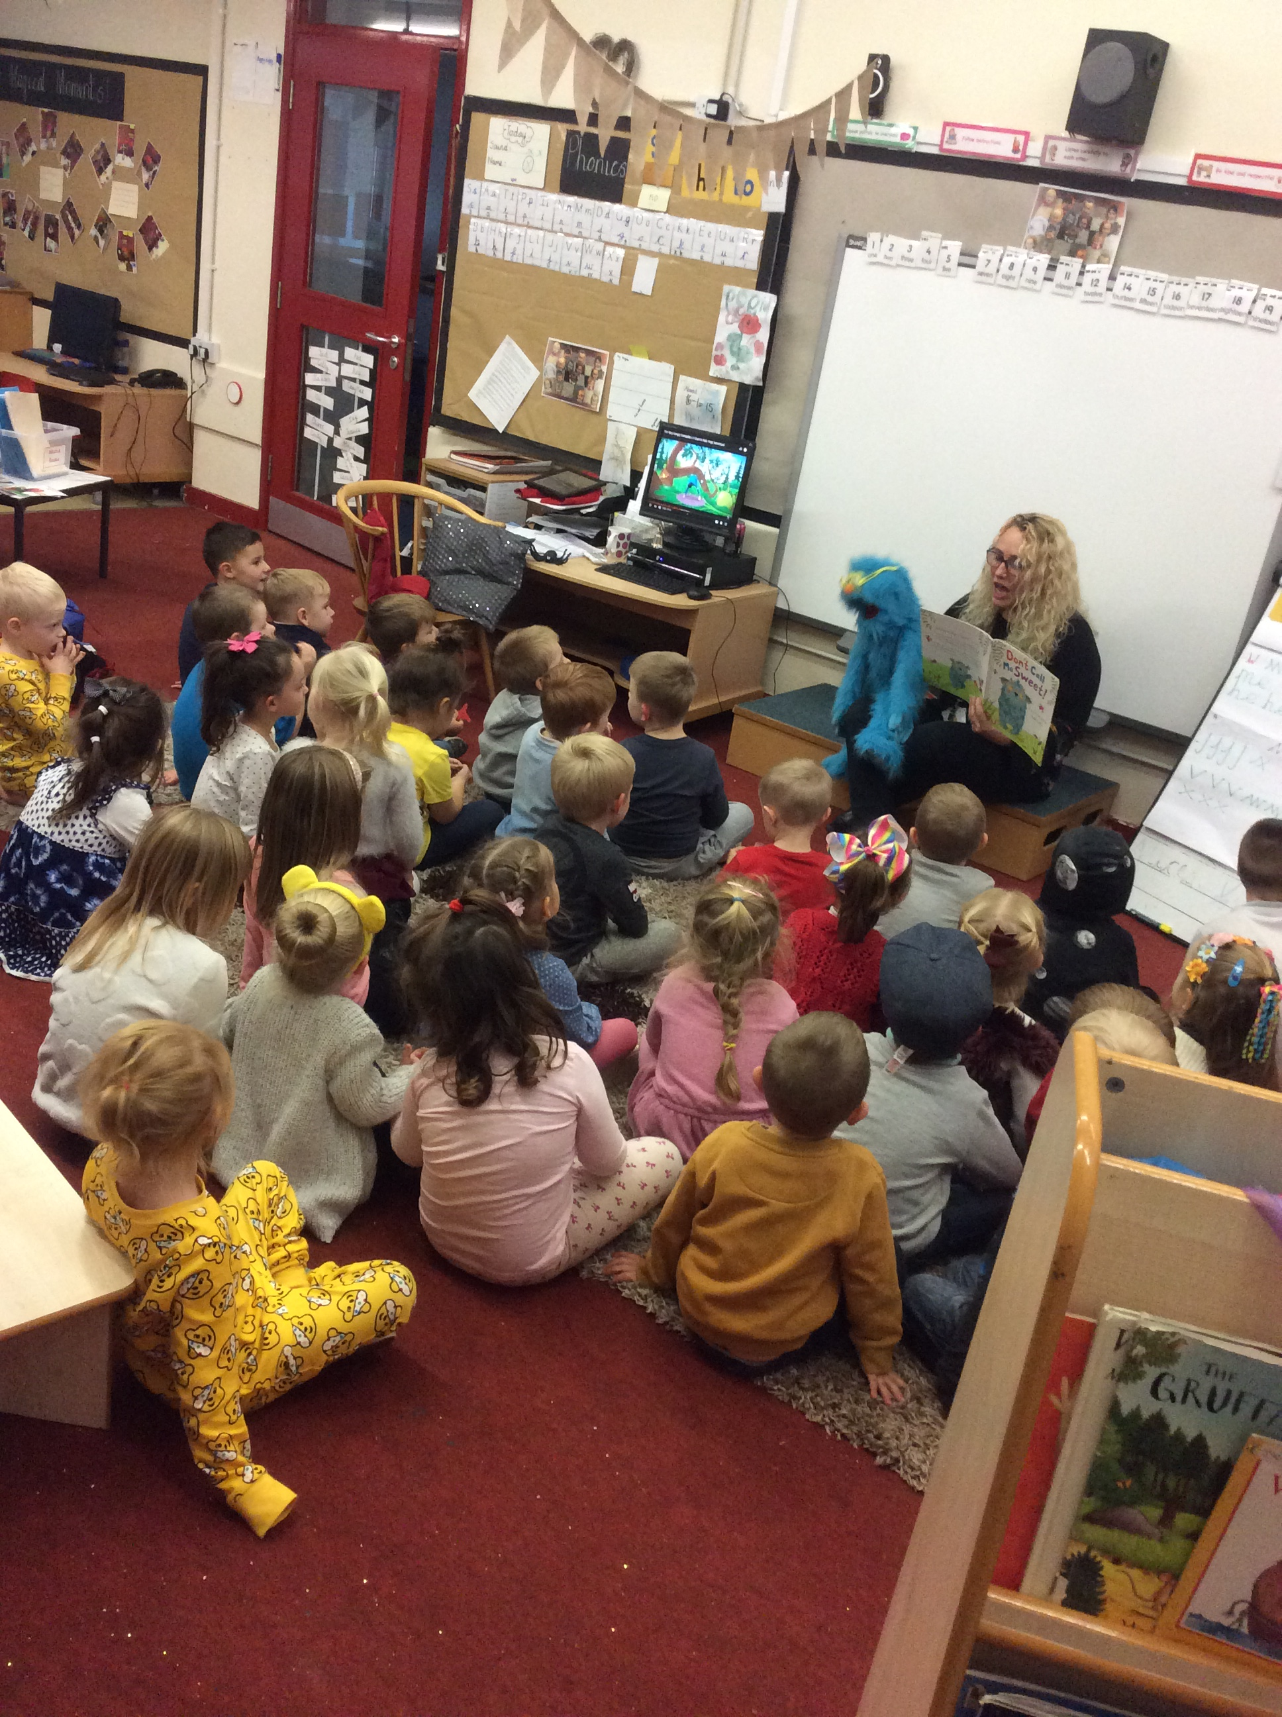
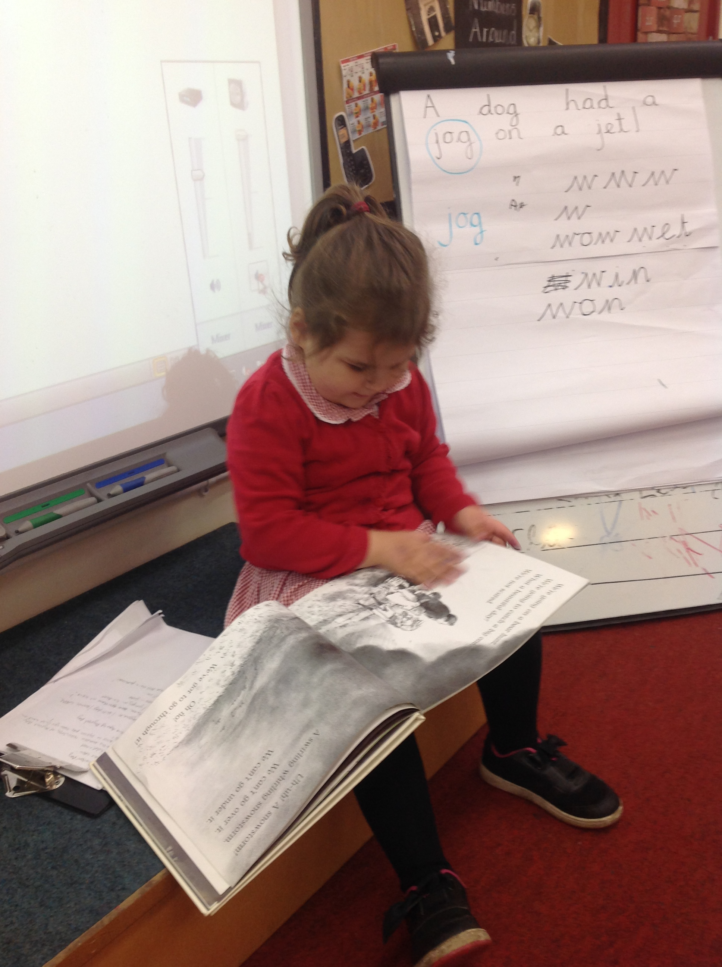
Reading with your child
K:\#Staff Only#\#EYFS 2019-2020\Parents\phonics and reading\IMG_4461.MOV

Slide 12

Reading with your child
Blending is process that takes time to learn. It takes a lot of practice (little and often).
Make time to look at the pictures and for book talk.
Little and often. 5 minutes as a special time.
Always be enthusiastic about reading and books and be a role model. The children need to see you enjoying reading yourself. All print not just books.
Always ask lots of questions this really helps to support your child understand what is happening in a book and helps them to understand new meanings of words.
Model reading and show how important it is as children will copy what they see!
Back page of book.

Slide 13
The single greatest factor in a child’s ability to read is early experiences of being read aloud to

Slide 14


Slide 15
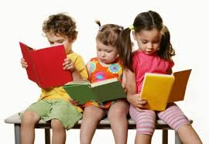
1,000,000+ word gap
Young children who are read five books a day, enter reception having heard about 1.4 million more words than children who were never read to

Slide 16
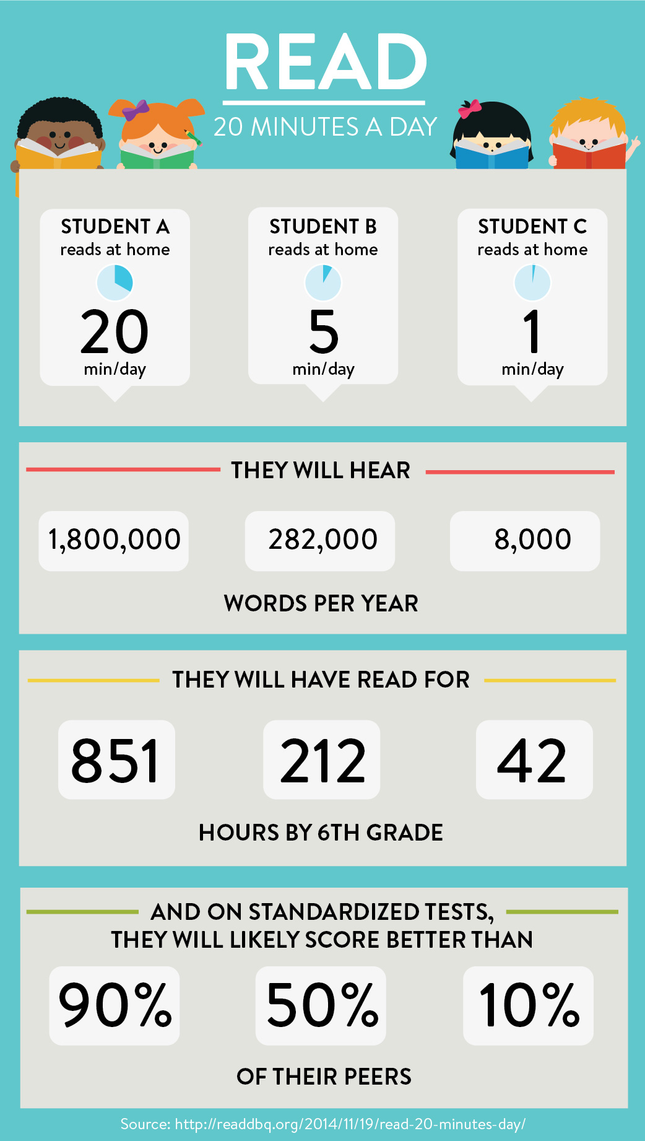
Barwic Study

Slide 17
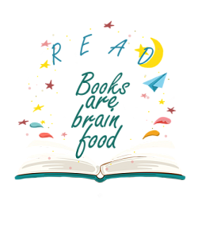
Improves writing and speaking ability
Life-long reading habits
Improves listening skills
Academically stronger
Bond with your child
Increase vocabulary knowledge
More likely to get a better paid job
Improves brain development
Better at communicating
Contributes to positive mental health
More imaginative

Slide 18
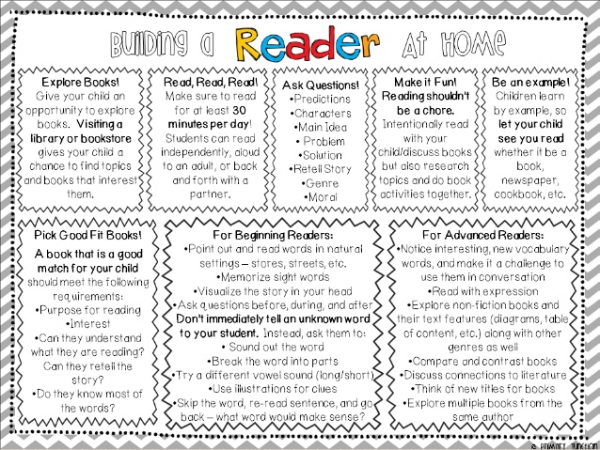

Slide 19
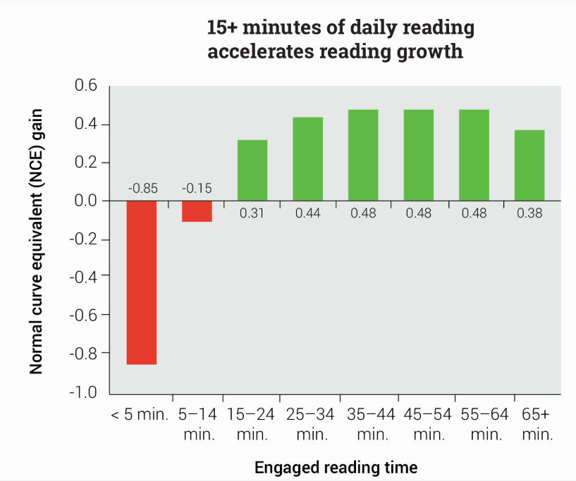

Slide 20
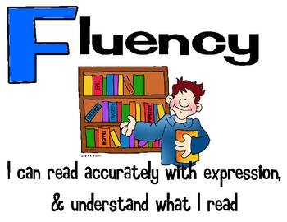

Slide 21
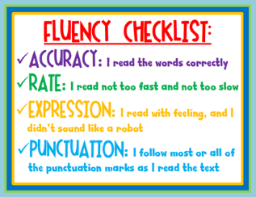
Model
Re-read
CEW

