Slide 1
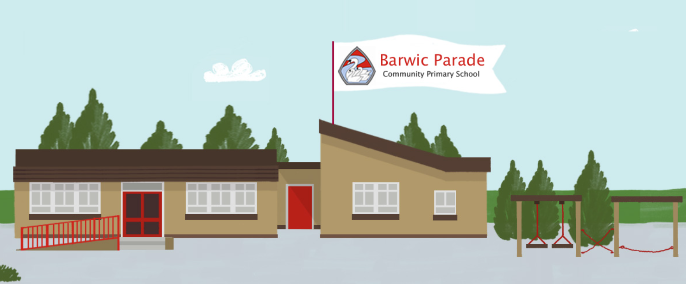
Year 1/2
Welcome to our year 1/2 parent meeting. We hope you find it informative.

Slide 2
Meet the team
Becky Kirkland – Key Stage 1 Leader / Inclusion Lead/ Year 2 Class Teacher - Germain
Amy Ault & Sarah Nutbrown – Year 1 Class Teachers - Benedict
Mrs Betteridge, Mrs Fawcett & Mrs Waring – Teaching Assistants

Slide 3
Planners
Homework
Your child will have their logins to spelling shed stuck in their planner. They will also have their spelling test score written in each week.
All planners must be in school every day - they are vital for communicating with you, noting when children have read in school and recording results. Planners will be checked daily in school.
Homework will be set each Friday and will be due in the following Friday.
Paper copies will sent home. Weekly homework will include spellings and an additional task linked to the children’s current learning.
Children are expected to read each night.
Children will miss their break/lunch time during school in order to give an opportunity to complete any missed homework.

Slide 4

The curriculum: English
Research has proven that children who read regularly and are confident readers are more likely to develop better vocabulary, become better writers, develop better maths skills and have more positive mental health.
Reading broadens their horizons and allows them to better access the curriculum as a whole. Reading certificates will be awarded based on home reading. Children should be reading for around 15-20 minutes per night. We will count up to 14 reads per week. This allows for children to read substantially (more than just a page or two) twice a day. Reading with your child at home is something which will absolutely make the biggest difference in your child’s learning.
Children will access the library where they will be able to chose a book to read for pleasure!

Slide 5
The curriculum: English
During writing sessions, children will continue to use our sentence stacking approach for fictional narratives. They will also develop their skills in poetry, non-fiction and through book studies.
We are working relentlessly on composing a sentence at the moment. Ensuring children are using capital letters, finger spaces and full stops. Year 2 are also using adjectives (delicious), conjunctions (and, but, so) and even exclamation marks. We have to nail this before we can move on so any support that you can offer at home would be welcomed. Ask your children to write your sentence and then tell them to bring it in to show us! We always want to see really great work! ☺

Slide 6
The curriculum: maths
Children will be working hard to consolidate basic maths skills. We will be working really hard over the coming weeks to really focus on using the four operations so what can you do to help your children?
Number bonds to 10, to 20 and even 100 – practice, practice, practice!
e.g. 2 +8 = 10 14 + 6 = 20 80 + 20 = 100

Slide 7
PE
Please ensure that your child is wearing the appropriate kit and footwear on the days they are scheduled to have PE.
As per the school policy, this includes a white t-shirt, black tracksuit bottoms or sports leggings and trainers or pumps. Football kits, t-shirts and hoodies with logos, normal leggings and any form of crop top are not permitted.
Children without PE kit or who are not wearing the appropriate kit will be asked to wear spare kit provided by school. If children wear earrings, they must be able to remove them before the lesson.
Outdoor PE sessions:
Monday – Benedict
Friday – Germain
Indoor PE sessions:
Monday – Germain
Thursday – Benedict

Slide 8
The curriculum: Phonics / Spelling
In Year 1 the children are consolidating their Phase 3 letter sounds as we found that although many children knew the letter sounds, they weren’t always able to confidently apply them to read and write words and sentences. After half term we will be beginning Phase 5. Phase 3 and Phase 5 letter sounds appear significantly in the Year 1 Phonics Screening Check, which takes place in the summer term. We want all of our children to be confident, fluent readers by the time they leave Year 1.
We teach phonics at 9am. If your child is late to school it has such a huge impact on their phonics learning and their ability to read effectively.
In Year 1 the homework is reading and spelling. The spellings and reading books reflect the phonics learning. Please make sure that you are reading with your child everyday and writing in their planner. Spellings are set on a Friday and we have a spelling quiz every Friday too. Please make sure your child’s green homework book comes into school every Friday and they have the opportunity to practice their spellings throughout the week.

Slide 9
Attendance/lateness
As you may be aware, attendance continues to be a focus at Barwic Parade. We understand that sometimes children are unwell but, wherever possible, it is important that your child attends school and is on time. Below outlines just a few of the consequences for your child’s learning if they are late:
Arriving 5-10 minutes late to school- you child misses their first task of the day. If this were to happen every day, it would add up to your child missing 6 days worth of school a year!
15-20 minutes late to school– your child will have missed their Phonics/Spelling Session. This then sets them back for the next day’s learning.
Anything later and your child misses their maths and English sessions too. Missing one of these sessions might mean they’ve missed a key building block to learning that is difficult to catch up.
Doors will open each morning at 8.45am. Gates will be closed at 8.50am. After this time, children will need to arrive via the office.

Slide 10

Visiting the Library
The children will have the opportunity to visit the library once per fortnight. They absolutely love to go to the library so we want to make sure that they continue to have this great opportunity. It is really important that we teach them how to look after books and take good care of them. Please make sure you talk to your children about this and also keep an eye on planners so that they are returned and renewed in a timely manner.

Slide 11
Behaviour
We continue to focus on the positive behaviour that we see in our school and ensure that all children are recognised for making the right choices, both in behaviour and learning. We want to make sure that parents feel fully supported and fully informed of their child’s behaviour and achievements. Here is an overview of our behaviour policy:
Our school rules are:
Ready Respectful Safe
READY – ready for learning and working collaboratively with peers and adults (including correct uniform and equipment).
RESPECTFUL – everyone is polite and well-mannered. We respect each other and the environment.
SAFE – we are safe in our actions, our words and our behaviour. We are safe online, within the community and in relationships.

Slide 12
Zone board
Platinum – Going ‘above and beyond’ – something that really stands out and is a great deal. Not a ‘one time only’ occurrence consistently outstanding behaviour or work over the course of a week.
Gold – Working exceptionally hard or showing exceptional behaviours within a lesson or over the course of the day. More than just following the school rules.
Silver – All children will start the day here. They are following school expectations and rules at all times.
A clear warning will be given before a child is moved down the zone board. The verbal warning will state the behaviour that needs changing.
Blue - low level disruptive behaviour.
Purple - persistence of blue behaviour, showing disrespect and rudeness or behaviour worsening.
Red – behaviour persisting form purple, instant = swearing, physical, violent, serious challenge of school rules i.e. refusal to do work.

Slide 13
Zone board: rewards
Affirmation Cards
These cards communicate a positive message to children that are standing out or going over and above consistently in their work or behaviour.
Gold: Best Seats in the House
Teachers will choose 1 child from their class who has been in gold, and they will be invited to sit on ‘the best seats in the house’ during the Friday celebration assembly. Children in gold will receive a gold sticker in their planners. Parents are to sign to show acknowledgement.
Class VIP/star of the day
At the end of each day, each teacher will pick a class ‘VIP’ or ‘star’. Also, a celebration message will be sent home to the parents of the chosen VIP.
Star of the Week
Each week, teachers will choose a Star of the Week. The chosen child is to be rewarded a certificate during the Celebration Assembly every Friday and their parents are invited into school to join in on the celebration.
Head Teachers Recognition Award
Each week, the Headteacher chooses one child to receive a ‘Recognition Award’ during the Celebration Assembly. Their parents are invited into school to join in on the award.

Slide 14
Zone board: consequences
If a child is moved down on the zone board they will be told why, what rule they have broken and what they need to do to get back into the right level.
Below are consequences for if a child moves into Blue, Purple or Red zone:
Blue: Miss a break time.
Purple: Miss break time and lunch time.
Red: Miss break time and lunch time for the day / next day. Child to be sat outside the headteacher’s office to complete work for the rest of the day/ next day. Alternatively, your child may be moved to another classroom to carry out this consequence.
When a child reaches ‘Purple’, a slip will be sent home the same day that outlines why they have been moved down & the consequences - this slip is to be returned signed by parent/ carer.
If a child reaches red, a phone call home will be made the same day by the staff member who gave the red, to discuss the incident and the consequences.

Slide 15
Any questions?

